Slide 1



BONICE SELLERS
Selling Bonice:
A Job of Great Worth

Slide 2

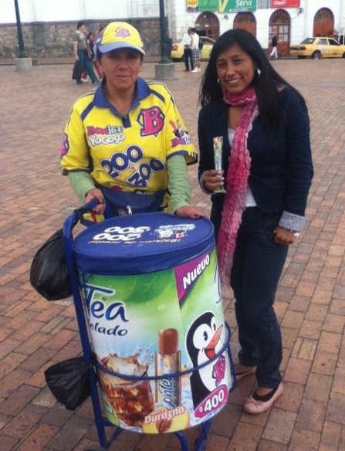
INTRODUCTION
Raise awareness on the job and living conditions of Bonice sellers.

Slide 3
OBJECTIVES
General Objective
To raise awareness on job and living conditions that Bonice sellers face.
Specific Objectives
To find out the income of Bonice Sellers.
To determine the schedule of Bonice Sellers.
To know the social status of Bonice sellers.

Slide 4
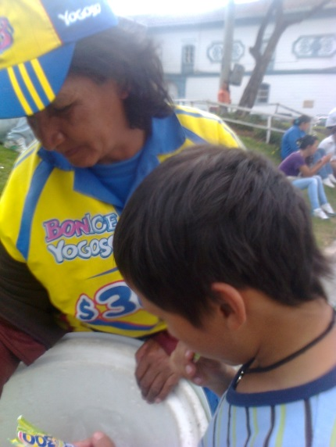
PROCEDURE
How to approach them?
LETTER
SURVEYS
INTERVIEWS

Slide 5
PROCEDURE
Experience
PEOPLE
Respectful
Easy-going
Responsible
6 Bonice
Sellers
RESEARCH
Nice, Easy, Profitable

Slide 6
RESULTS
INCOME

Slide 7
RESULTS
INCOME

Slide 8
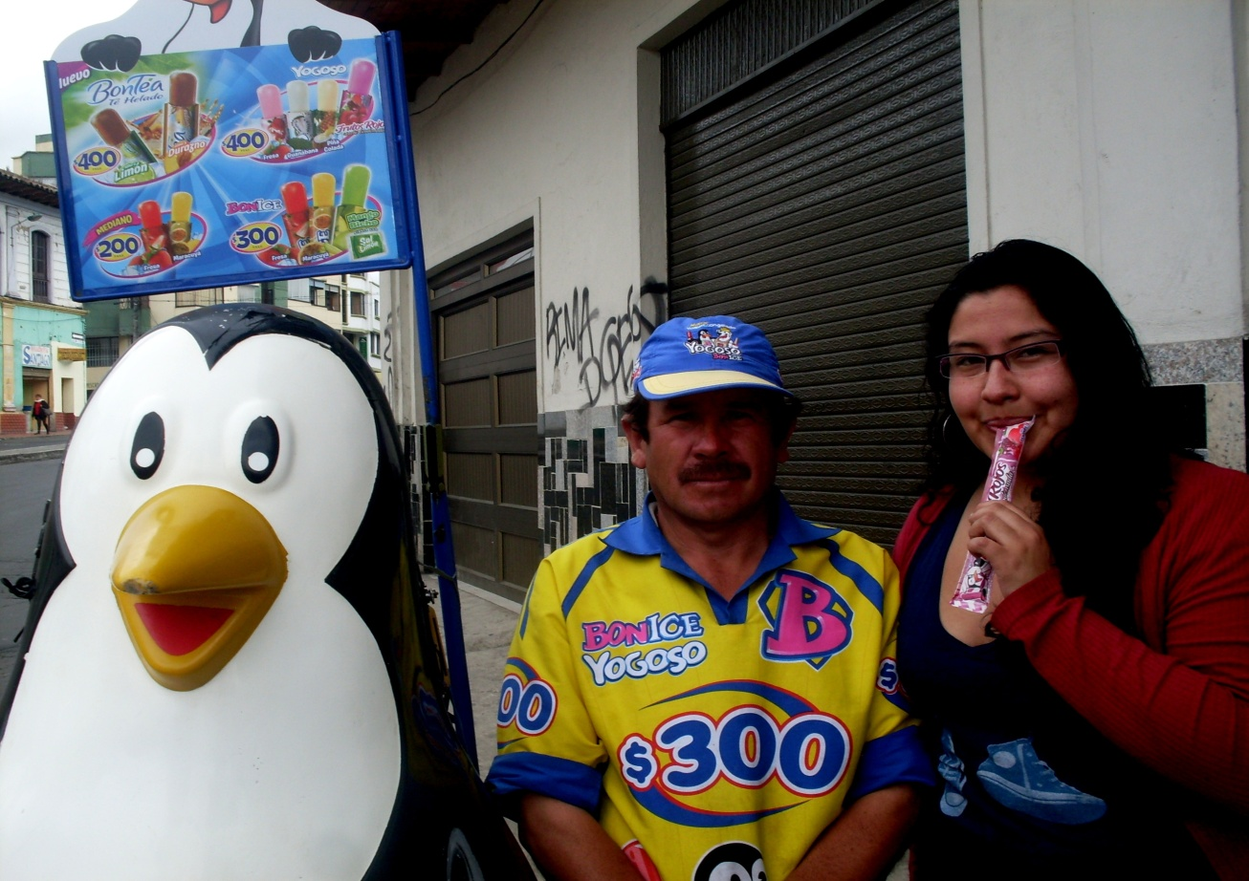
RESULTS
Schedule
Social Status
Estrato 1
Afiliado
Risks

Slide 9
CONCLUSIONS
A handful of Bonice Sellers are illiteracy people.
Lack of labor opportunities.
Proposed objectives were achieved.

Slide 10
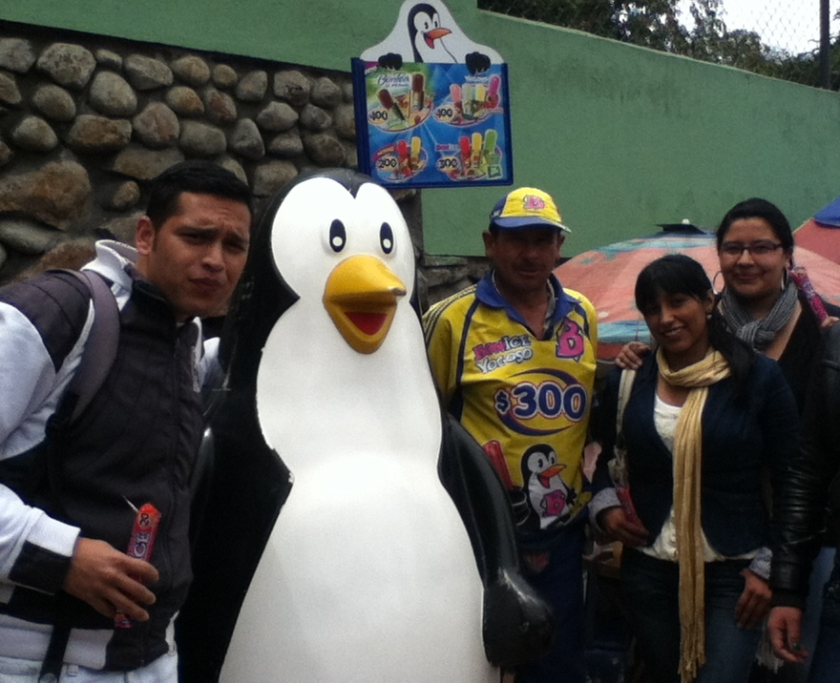
THANK YOU !
Angie Medina angiesitalizz05@hotmail.com
Eduardo Morales edumorales-1987@hotmail.com
Alejandra Noguera alejita0492@hotmail.com

